Slide 1

NFHS Rules Exams
Step By Step with Pictures

Slide 2
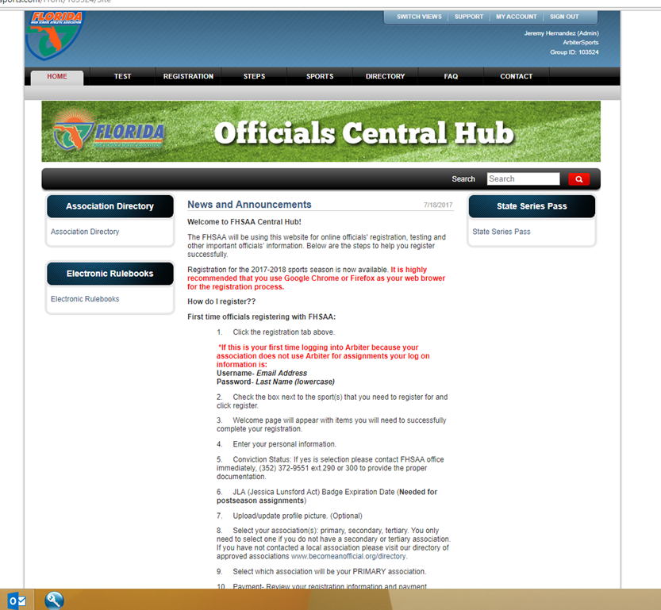
Step One: Go to www.fhsaa.arbitersports.com.
Log into your Arbiter account.
Click the tab labeled TEST.

Slide 3
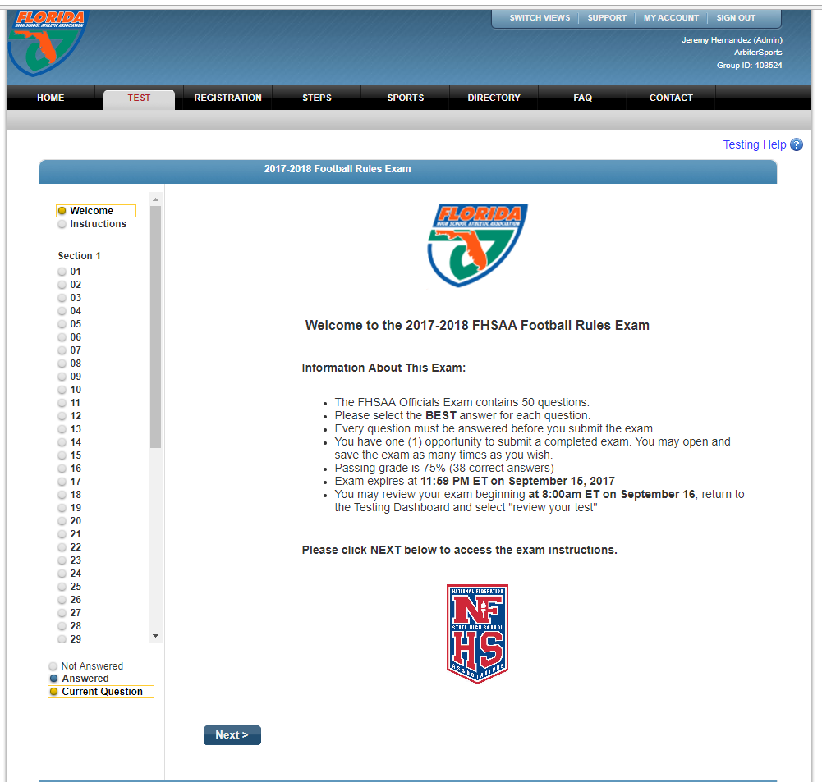
Step Two: Read through the Welcome.

Slide 4
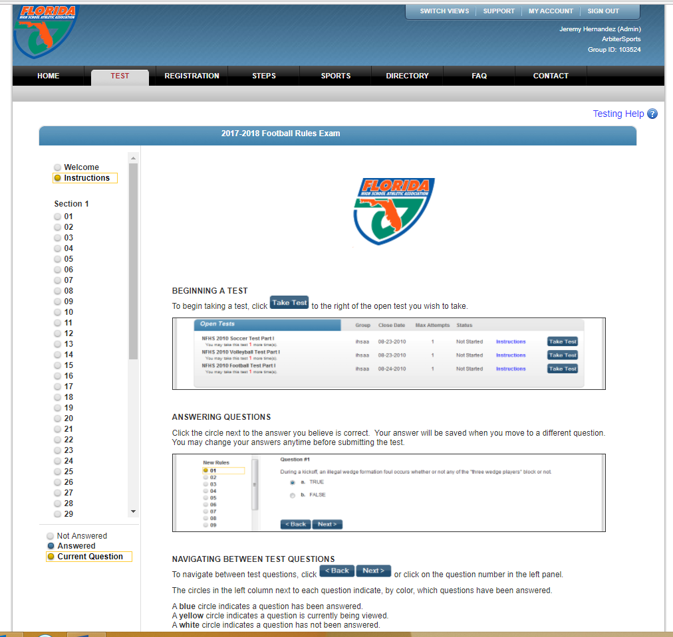
Step Three: Read through the Instructions.

Slide 5
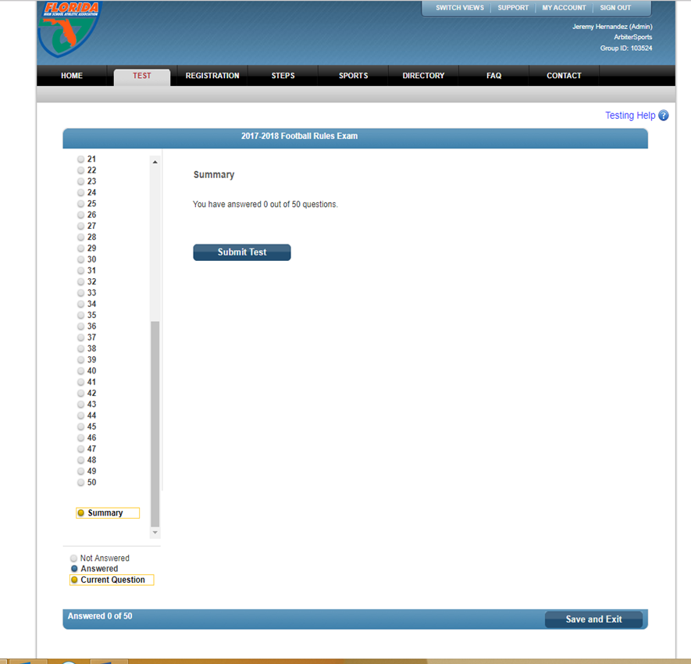
Step Four: Submit Test or Save and Exit.
Once you complete your exam click Submit Test.
If you do not finish it, click save and exit and you can come back and pick up where you left off.

Slide 6
If you experience any problems please contact the FHSAA at (352) 372-9551 extension 290 or 300.

